Slide 1
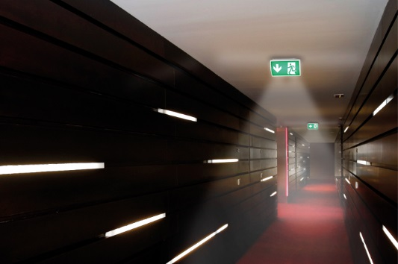
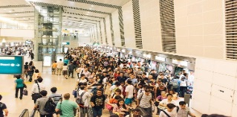
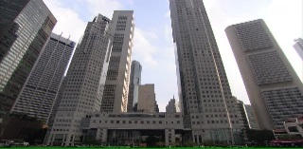
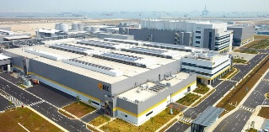
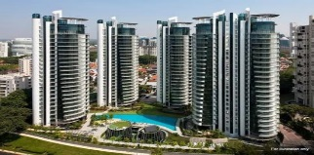
ezCHECK FOR EMERGENCY LIGHT
Lighting the Way to SAFETY
The timely evacuation of building in case of fire, smoke or other emergency, is an essential part of safety in the industrial, commercial and residential environment.
Emergency Lighting Equipment
Emergency lighting system is a safety device that comprises a back-up battery system that switches on automatically when a building experiences power outage.
Maintaining visibility is critical for occupants to navigate their way in such cases is essential; this is the task entrusted to emergency lighting systems. Ensuring they operate properly when required is crucial.
They are essentially a life saving equipment strategically placed to provide light, directions and to signpost escape routes during an emergency or fire, where there is darkness, in unlit or poorly-lit places or when there is smoke around.
Manual or Automatic Testing
As emergency lighting systems are safety-related products, their designed performance can only be assured by systematic testing and maintenance. Conventional manual testing procedures are highly susceptible to oversight or neglect.
These limitations can be overcome by automating the testing process and installing ATS (automatic test systems). It is essential that ATS for emergency luminaires (light fittings) should schedule tests reliably and provide timely notification of failures or degradation of performance.
- ezCheck is a module that can be programmed to performs scheduled tests and logs the results.
- ezcheck can be installed onto the Emergency Lighting System to safeguard the basic functionality of the Emergency
power source.
Public Places
Airports
MRT Stations
Shopping Malls
Hospitals, etc
Commercial Building
Offices
High Rise
ATS
Self Test
Discharge Test
Data Logging
Centralized
Mobile Device
Industrial Premises
Manufacturing
Warehouses
Residential Building
Condominium
Town Houses
Service Apartment

Slide 2
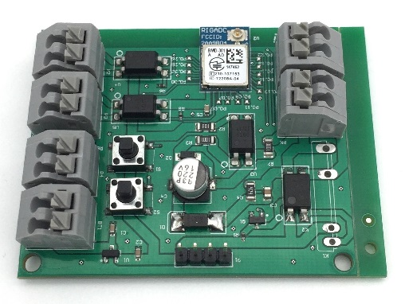
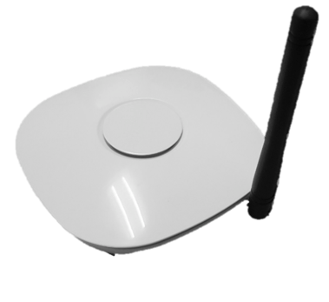
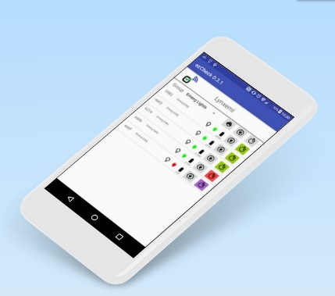



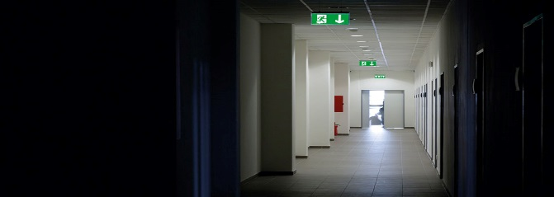
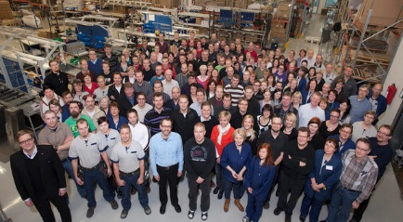
ezCHECK FOR EMERGENCY LIGHT
Tangibles
Avoid any potential legal liabilities from i.e. law enforcement, building occupants, etc. by eliminating Point of Time (POT) failures
Improve Labour Cost Efficiency as Cost Effectiveness
Reduce unnecessary replacement costs
ezCheck ATS module
ezCheck ATS Gateway
Intangibles
Proactive and Preventive Approach
Ease of mind for Building occupants
Robust maintenance regime
Minimize safety risk due to power outage
Android or IOS Device
ezCheck Cloud and User Interface
For Illustration purposes only
Conform to SS563 Test Requirements

